Slide 1


LEAN MANAGEMENT :
Value Stream Mapping (VSM)

Slide 2
TENTATIVE PROGRAM – Day 1
TIME | No | ACTIVITIES
9.00 am – 1.00 pm | 1. 2. 3. 4. 5. | Ice Breaking Introduction on MPC Introduction to Lean Management System What is Lean? Lean Thinking Lean Principles Types of waste Value Added and Non Value Added Exercise 1 – Identify VA & NVA Lean Method ; Value Stream Mapping What is Value Stream Mapping (VSM) Why VSM is important tool VSM Step – Current State & Future State Components of VSM VSM; Step by step Getting Started Exercise 2 - Group Activities : Identify project
1.00 pm – 2.00 pm |  | Lunch
2.00 pm – 5.00 pm | 6. | Phase I - Current State VSM 10 Step in implementing VSM Exercise 2 - Group Activities : Step 1-7

Slide 3
TENTATIVE PROGRAM – Day 2
TIME | No | ACTIVITIES
9.00 am – 1.00 pm | 7. 8. | Phase II - Current State VSM with Opportunities Step 8 – Identify opportunities through: Kaizen Blitz and Burst Exercise 3 – Group Activities : Step 1 – 8 Phase III - Future State VSM Step 9 - Create future state VSM Step 10 - Kaizen action plan
1.00 pm – 2.00 pm |  | Lunch
2.00 pm – 5.00 pm | 9. | What make Value Stream Lean? 8 Rules Exercise 4 – Group Activities: Project Presentation Action Plan Conclusion

Slide 4

INTRODUCTION ON MPC

Slide 5
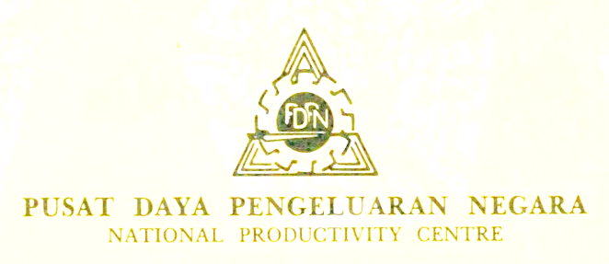


SEJARAH MPC
1962
1991
2008-until now

Slide 6
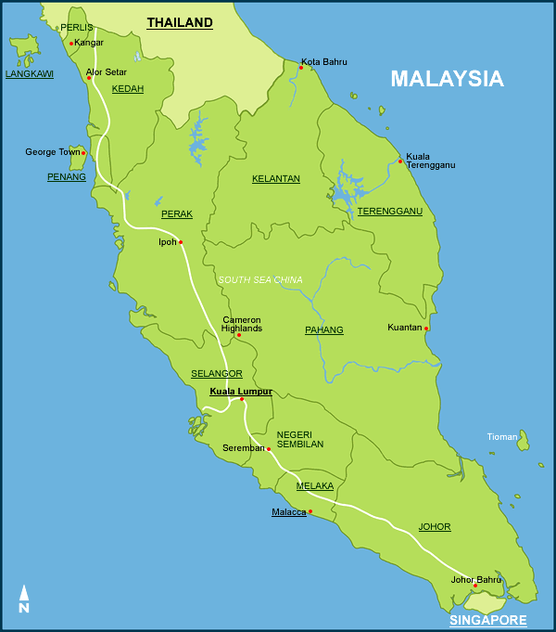
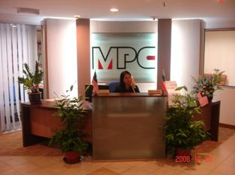
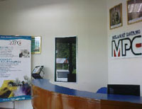
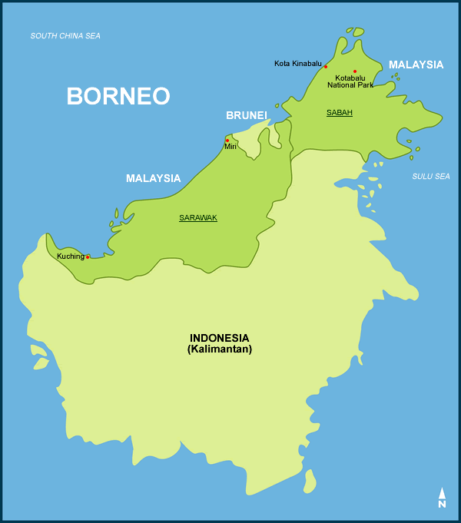

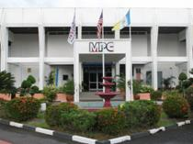
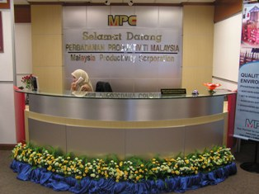
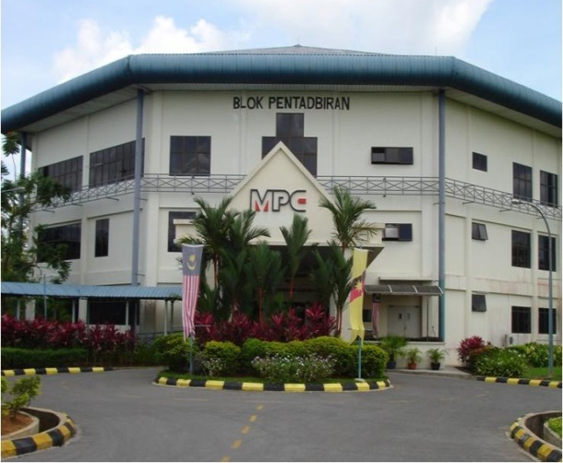
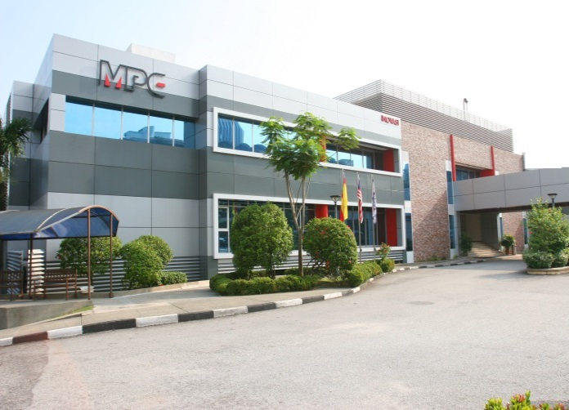
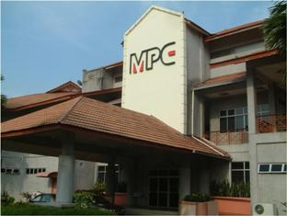
MPC HQ & Regional Office
MPC Pejabat Wilayah Kelantan
MPC Wilayah Sabah
MPC Wilayah Utara
MPC Pejabat Wilayah
Terengganu
MPC Wilayah Sarawak
MPC Pejabat Wilayah Pantai Timur
MPC Ibu Pejabat, P. Jaya
MPC Wilayah Selatan

Slide 7
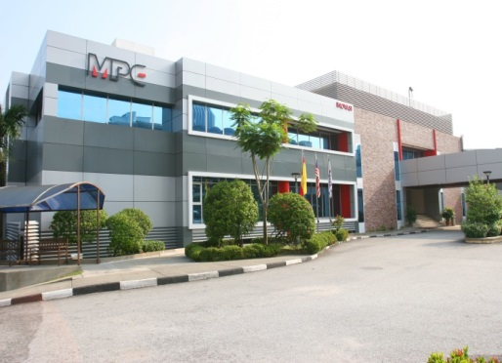
VISION
The leading organisation in productivity enhancement for global competitiveness and innovation
MISSION
To deliver high impact services towards achieving performance excellence through innovation for the betterment of life

Slide 8
OBJECTIVES MPC
Providing value-added information on productivity, quality, competitiveness and best practices through research activities and databases.
Developing human capital and organisational excellence for building a knowledge-based society through training, systems development and best practices.
Nurturing innovative and creative culture for productivity and competitiveness through partnership programmes.

Slide 9
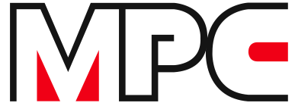
FUNCTION MPC
ENTERPRISE
INNOVATION
REGULATORY
REVIEW
GLOBAL
COMPETITIV-ENES
KNOWLEDGE MANAGEMENT
BUSINESS
EXCELLENCE

Slide 10
MPC LEAN- QE HIGH IMPACT ROAD MAP
5S + KAIZEN +
LEAN MANAGEMENT
5S + KAIZEN
5S
Specific Continuous Improvement
of the Technique/
Practices used
in Existing 5S System Especially in Quality and Product Delivery
Continuous Improvement
of the Technique/
Practices used
in Existing 5S System
Technique / Practices used
to Establish and Maintain
Quality Environment
in Organization
Clean and conducive
work place.
Proper storage and
management of
documentation.
Well maintained tools
& equipments.
Developing responsible
and accountable
attitude.
Save cost and more saving.
Practice correct working
culture.
Improve work productivity
and products quality.
Customer happiness.
Increase profitability.
Well developed an excellent
culture/ which conform to
International Culture.
More facilities and rewards
to staff.
Solid customer confidence &
trust/more order.
Respectable organization.
DEVELOPMENT
CULTURE
HIGH IMPACT

Slide 11
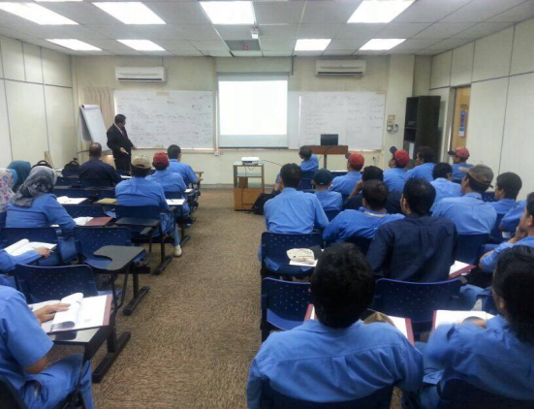
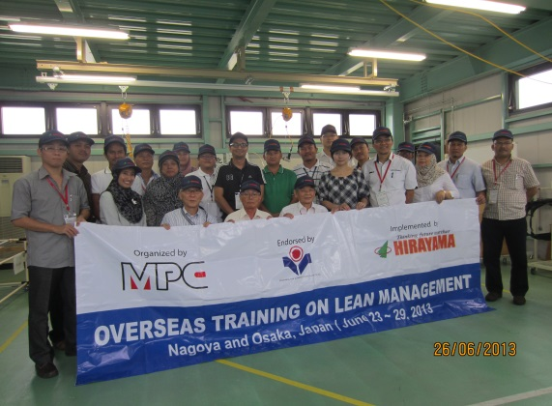
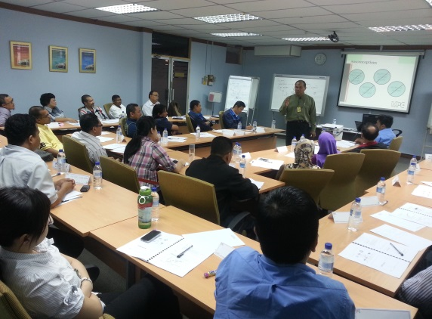
MPC’s PROGRAM on LEAN
MPC WPT sebagai CoE Pengurusan ‘Lean’
Misi Pembelajaran Antarabangsa
‘Lean Hands-on Workshop’
Program Peningkatan Produktiviti & Inovasi
Projek Pembangunan Sistem
Pengiktirafan ‘Lean’
Portal ‘Lean’ – www.leanmpc.com
Mewujudkan ‘Lean Database’

Slide 12
Objectives Program
This module aims to provide :
Understanding Lean concept
Fundamental guidelines in implementing Value Stream Mapping
Demonstrate Value Stream Mapping as a tool to support Lean implementation

Slide 13
Introduction to
LEAN MANAGEMENT SYSTEM

Slide 14


WHAT IS LEAN?
Lean refers to a collection of principles and methods that focus on the identification and elimination of non-value added activity (waste) in any process
James Womack, Daniel Jones, and Daniel Roos coined the term “lean” in their 1990 book The Machine that Changed the World to describe the manufacturing paradigm (often referred to as the Toyota Production System) developed by the Toyota Motor Company based on principles pioneered by Henry Ford.

Slide 15
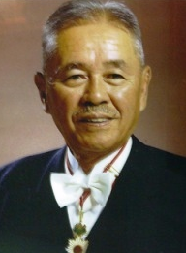
LEAN THINKING
(by Father of Lean)
“Lean enable the production and delivery of the right amount of high quality products and service (as defined by your customers) at the right time at the first time while minimizing waste and being open to change…”
Taicchi Ohno
Father of TPS, Kanban
Production Engineer Toyota

Slide 16

LEAN THINKING
“LEAN IS… A mindset, or way of thinking, with a commitment to achieve a totally waste-free operation that’s focused on your customer’s success….
It is achieved by simplifying and continuously improving all processes and relationships in an environment of trust, respect and full employee involvement….
It is about people, simplicity, flow, visibility, partnerships and true value as perceived by the customer.”
David Hogg
High Performance Solutions

Slide 17
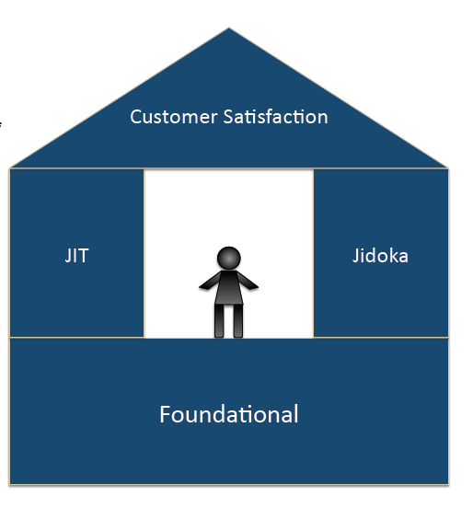

LEAN & TPS HOUSE
Lowest Cost
VALUE STREAM
MAPPING (VSM)
POKA YOKE
Highest Quality
Shortest Lead Time
SPAGHETTI
DIAGRAM
ANDON
5S
TAKT TIME
VISUAL
CONTROL
KANBAN
SMED/OEE
Standards
Customer First
Genchi Genbutsu
Safety
Stability
Respect for Humanity
Process of making continuous improvements
in both your personal and work life.
The direct translation is KAI = CHANGE and ZEN = GOOD.
KAIZEN
Notes:
Jidoka – sakichi toyoda
JIT – Taichi ono, eijji toyoda

Slide 18









LEAN HOUSE
Single Piece Flow
Lean System
KANBAN
ANDON
Efficient use of:
Just-In-Time
People
Equipment
Material
Space
Improve process capability
Minimize variation
Manage abnormality
Built-in Quality (Jidoka)
Pull System
TAKT Time
POKA YOKE
Workload Leveling (Heijunka)
SMED
Stable & Standardized Processes
Visual Management System
VSM
HEIJUNKA Level Schedule
Standardize Work
Multi Skills Workers
Visual Control
5S

Slide 19

WHY IS LEAN?
Lean focuses on the related process
Lean has a measurable impact on time, capacity, and customer satisfaction.
3. Lean involves employees.

Slide 20
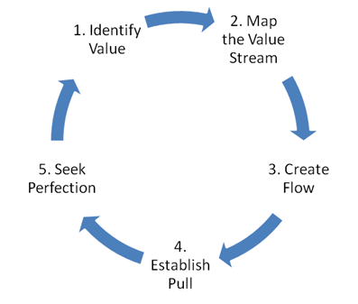
5 PRINCIPLES OF LEAN THINKING
Identify Customers and Specify Value
Identify and Map the Value Stream
Create Flow by Eliminating Waste
Respond to Customer Pull
Pursue Perfection

Slide 21
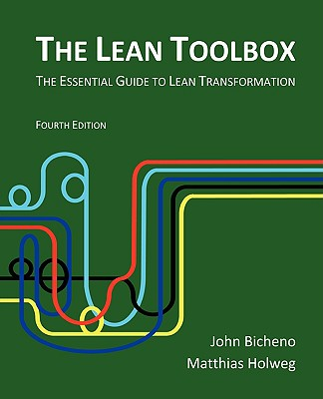
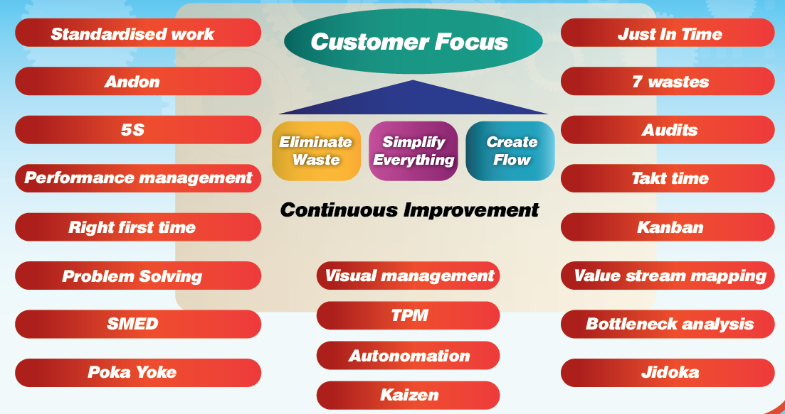

LEAN TOOLS

Slide 22



LEAN IN GOVERNMENT
The “Lean Method” Approach to Performance Excellence
Super-factory or Super-Government with Lean

Slide 23
Why Government MUST embark on Lean?
Government faces economic difficulties and rising cost in recent years. This is further impacted with:
  Country revenue have not rebounded
  Federal funds and reserves will won’t last forever
  Rising administration cost year after year
  Inefficiencies in handling projects or
  Inefficient process flow
  Borrowing and Loans is in the increasing trend
  Other cost cutting measure is taken and ongoing

Slide 24
Efficient and effective Lean Services or Manufacturing can be achieved…Why?
Government or manufacturing sector is under increasing pressure to:
Reduce waste or NVA
Reduce costs and expenses
Expand services with less resources (effective and efficient service)
Improve processing time (improve cycle time)
Increase productivity (remove non-value added activity)
Improve quality of services (less mistake)
Meet customer satisfaction and expectations

Slide 25
What make Lean so promising in service and manufacturing sector?
A customer-driven waste reduction technique that:
It focus and examines on current process or operations
It improves efficiency by decreasing process time or Cycle time.
Produces a product or service to the “beat” of customer demand
Measures impact on time, capacity and customer satisfaction
Initiates organizational change by involving employees participations
The relentless pursuit of waste.

Slide 26
TYPES OF WASTE

Slide 27

Focus to reduce the 8 Types of Waste
(Sources of Non-Value-Added Activity)
2. Over production
5. Transportation
6. Inventory
8. Over processing
7. Motion
1. Defects, Rejects, Rework
3. Waiting
4. Talent & miss-use of resource
Notes:
Lean looks for waste. There are 7 wastes which together result in underutilized employees.
For instance, during the initial day of the Kaizen event, team members look for elements of waste in the process. What are wastes and how can we best define them?
( attn trainer - The following are simply examples. Feel free to use your own.)
We could ask –
Does the customer pay us for repeated QA inspections? (picking, packing, shipping) – overprocessing What if we could package product at the end of the production line for direct movement to the shipping dock for a specific order?
Would the customer pay us for producing excess inventory that has the potential of becoming obsolete? Why do we have inventory anyway? Is it because the customer demands it? Why does the customer demand it? Are they concerned that we can’t meet their demand otherwise?
Would the customer pay for the extra steps and/or time an operator takes to retrieve a missing tool? How about the time the next operator is waiting for the missing tool to be found?
Does the customer pay us for moving the product from the end of the production line to inventory? Does the customer pay us for receiving the product into inventory?

Slide 28

1. Defects
Anything that has to be redone, incomplete or incorrect. Employees probably know what work often has to be redone Incorrect or incomplete work delivered to the next process (the customer)
Results in rework
Causes of defects:
  Weak process control
  Incorrectly processed order
  Inadequate education/training/work instructions
  Misunderstanding of customer needs

Slide 29
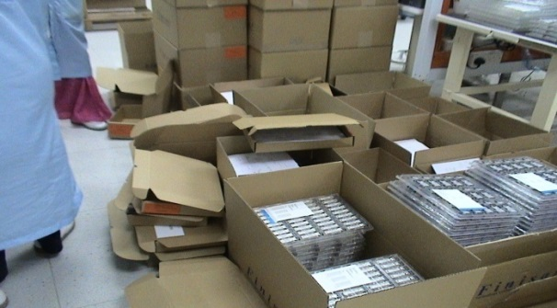

2. Overproduction
When too much or more of something is produced (e.g., information) or when something is produced too early and faster, while the downstream customer (internal or external) waits for something else.
Leads to excessive inventory
Causes of overproduction
  Generating reports that are not needed
  Emails sent to people who do not need to receive them
  Misuse of automation
  Long process setup
  Unbalanced work load

Slide 30

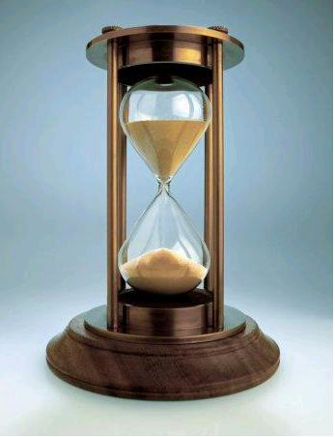
3. Waiting
Waiting for anything – people, task, paper, signatures, approvals, etc. This idle time is created when waiting for invoices, copier, parts, materials, machines, information, signatures, help, approvals, special task, etc.
Lead to time waste which is money / cost
Causes of waiting:
  Unbalanced workload
  Too few office machines
  No clear office protocol
  Upstream quality problems
  Waiting for a signature approval

Slide 31
4. Not using employees
Failing to take advantage of employees’ skills. For example, does management seek out their ideas for improvement or put them in correct task? If so, do they act on them?
The waste of not able to use people’s Abilities, Skill and Knowledge (ASK) in appropriate place and time.
Causes of underutilized people:
Old way of thinking, politics, the business culture
Poor hiring practices
Low or no investment in training
Low-pay, high-turnover strategy

Slide 32
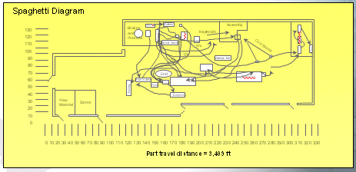

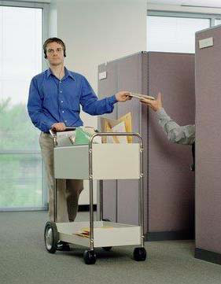
5. Transportation
Transporting time of documents and materials around the office until the next step. There is an opportunity for the process to break as work gets lost, misunderstood, etc. Minimizing the number of touches in a process is can make a process lean.
Movement of people that does not add value to the product or service
Causes of transportation waste:
  Poor office layout
  Processing extra paperwork
  Office processes that are not located near each other
  Poor understanding of the process flow
  Large batch sizes
  Large storage areas

Slide 33

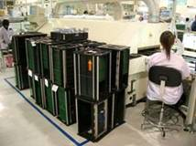
6. Inventory/backlog
Not just an abundance of supply, but also a backlog of work that leads to even greater waste as workers must spend time and effort managing and working around the backlog
Any supply in excess of one-piece flow
- Often the result of “Overproduction”
- Unbalanced workload
- Improper scheduling
- Unreliable suppliers
Examples:
Finished Good Inventory
Work In Process Inventory
Supplies Inventory
Staged or “kitted” Inventory
Solutions:
Make to Customer Order
Kanban Pull System
Eliminate Inventory Storage Areas
Identify bottle-neck or Use TOC

Slide 34

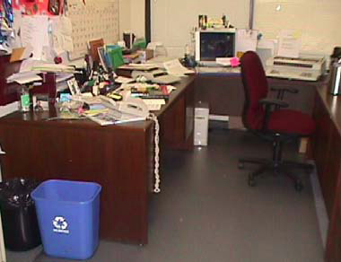
7. Motion
Excess motion on the part of the worker. For example, a poor office layout might require a worker to spend too much time walking between one point to another point where work equipment is located.
Movement of people that does not add value to the product or service. It is a waste in time and effort.
Causes of motion waste
  Poor people/machine effectiveness
  Poor office layout
  Inconsistent or no standardized visual work instructions
  Poor workplace organization and housekeeping
  Extra “busy” movements while waiting

Slide 35
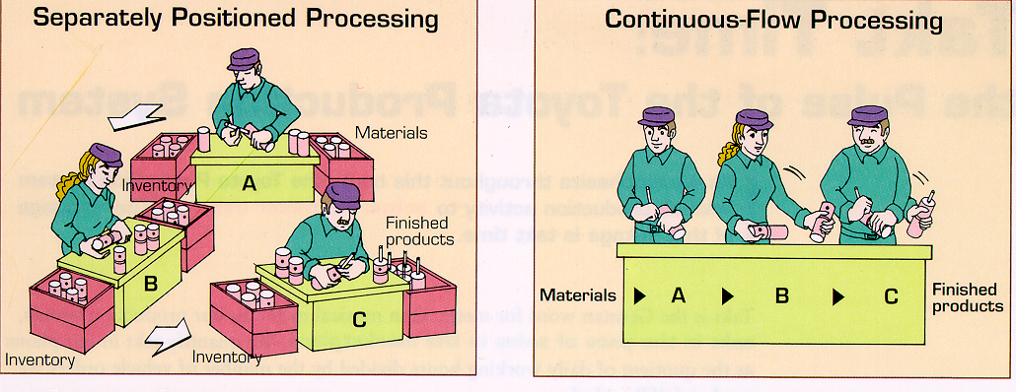
8. Excess processing
Extra steps or processing that does not add value, from the customer’s perspective (e.g., obtaining too many signatures or double- or triple-checking of work, extra testing).
Effort that adds no value to the product or service from the customers’ viewpoint. Customer is not paying for the waste…The organization cost will increase.
Causes of extra processing:
  Product changes without process changes
  True customer requirements undefined
  Lack of communication
  Redundant approvals
  Emails sent to everyone

Slide 36
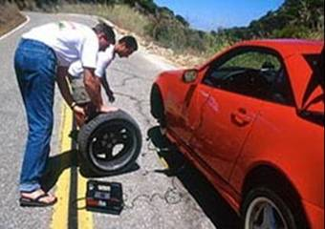
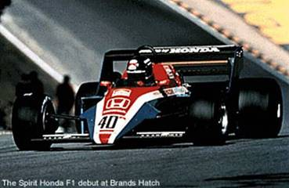
T1- Set up Reduction Time
The 4 Key Principles involved are
External Activities
Internal Activities
Parallel Activities
Streamline internal Activities
The Mind Shift
You
Approx. 15 mins.
F1 Formula- 8 sec. !!!

Slide 37
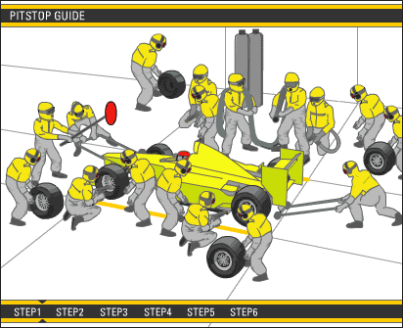
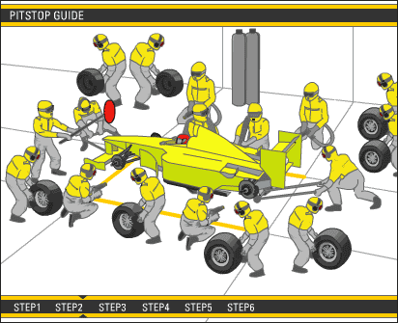
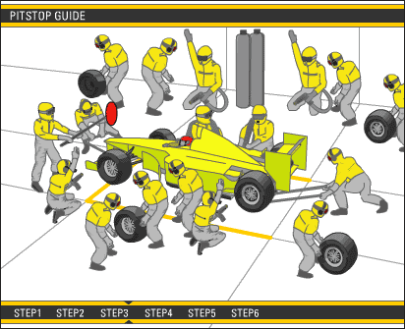
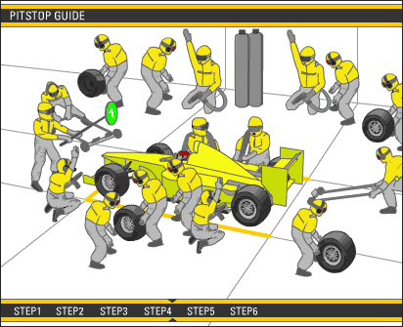
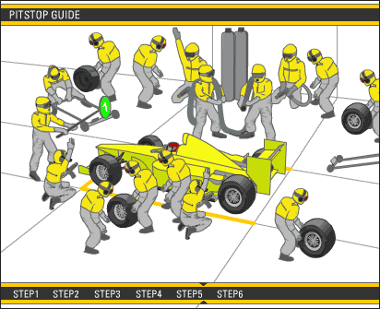
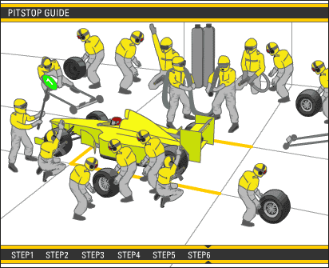
The Mind Shift

Slide 38
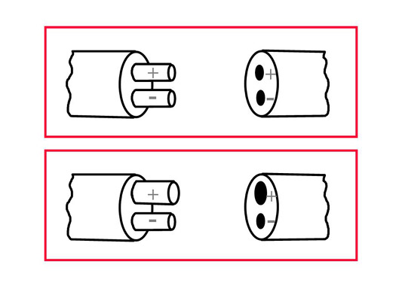

Example of Mistake proofing
Without mistake proofing, we can have a mistake with irreversible damages
With mistake proofing, error is not possible

Slide 39
One Piece Flow - Order entry - Before
Batch Orders
Open Mail
Calculate Batch Total
Stack and Hold
Enter Batch
Acknowledge
Orders
File Batch

Slide 40
One Piece Flow - Order Entry – After
Enter One Order
Open One Envelope
File Order
Acknowledge
One Order

Slide 41
T7 - Process Mapping / VSM?
What is a Process Mapping?: A visual representation of the flow of work in a series of steps showing the path of a process and the relationship between the steps.
Versions of a Process Map
Adapted from Product & Process Innovations, Inc.

Slide 42

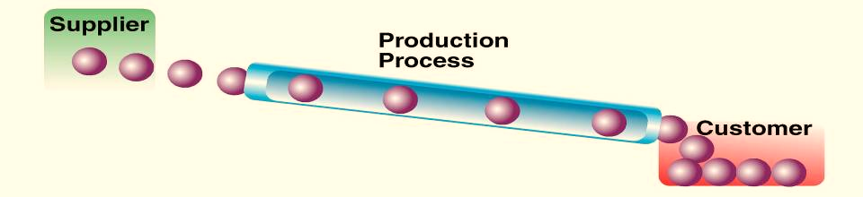
Steady Velocity - VSM
Traditional: Batch Production (like a meandering stream with many stagnant pools, waterfalls, and eddies)
When do we get our Parts?
2 WEEKS!
FLOW: One Piece Production: Pipeline with fast-flowing water or product
The right Job and it must keep moving
Notes:
42
Notice how One-Piece Production results in a straight, unimpeded process to meet customers’ needs?
Also, notice, One-Piece Production has no room for rework, no stopping off place for inspections. There is no place for inventory accumulation. There is also a steady demand – you’ll be hearing more about steady demand, referred to later as “TAKT” time.

Slide 43
TS - Example in Service Sector
Immigration Department – Online Vs Conventional method in International passport application.
  Cycle time reduce from week to hours
  Prevent queuing
  High customer satisfaction
JPJ Department – Online Vs Conventional method in driving license renewal.
  Cycle time reduce
  Prevent queuing
  High customer satisfaction
Banking Sector – Online / Internet banking or ATM Vs Conventional methods.
Security services – Manual guard service Vs security camera and alarm system (few areas can be monitored by one guard using CCT.

Slide 44
What is Waste Service sector?
Examples of Waste:
Document errors
Document transport
Completing work not needed
Process steps, reviews and approvals
Waiting for the next step
Searching for information
Backlogs
Behaviors
Developed by Products & Process Innovation, Inc. – following the Taiichi Ohno Model

Slide 45
How is it Done?
Must obtain management commitment
Make employees aware of what Lean is - Identify a process/procedure to be “Leaned”
Build employees desire to participate in Lean - Establish a Lean team (include people who do the work)
Give them knowledge about how to participate - Use Brainstorming/Process Mapping to identify “bottlenecks” and areas for improvement in day to day work
Implement customer-driven waste reduction techniques
Evaluate the results and make further improvements
Reinforce the change - Continue to find additional Lean projects within the unit

Slide 46
Barriers to Lean's Success
(Why do some LEAN events ‘Fail’)
The industrial jargon is a turn-off – Have impression that it cannot be implemented in Government / Service sector
Executives generally don’t focus about operations - Lack of alignment around improvement strategy
Unrealistic Expectations - The emphasis of Lean is on the wrong thing. Lack of understanding or missing skills
Difficult to buy-in or change the mindset towards Lean idea or Lean culture
Poor support and understanding from top Management - Weak or no leadership buy-in
Lack of Visible Management Commitment- Results not communicated
Inadequate Follow-up - Processes are not monitored and continuously improved
No sense of urgency
Source: Adapted from Karen Martin & Associates, “Building a Lean Enterprise: Navigating the Common Obstacles to Success,” Webinar Presentation, 13 May 2010, www.slideshare.net/KarenMartin2/building-a-lean-enterprise.

Slide 47
How to transformation Lean in a service or manufacturing Environment?
How Do You Lead the LEAN Transformation?
Link Lean to Organizational / Government Strategy
Obtain support of department head / upper management
Emulate Lean behavior or culture
Empower all staff to take responsibilities and sponsor the lean principles through-out the value chain
Encourage innovation through creative thinking
Think like a profit making organization - view lean as a long term journey
Instill a continuous improvement viewpoint

Slide 48
Actual savings – Success story
Expert experience
Connecticut Department of Labor’s
Reduce WIP CT – Estimated Saving US$ 120K.
13 Second Auto line Cycle time Reduction – Estimated Saving US$150K.
Improve the Recycle Media Yield from 54% to 80% - Estimated Saving US$380K.
Reduce the loss communication and routing fail in Cert Oven - Estimated Saving US$125K.
Reduce the Plant Electricity usage on Air-Con System - Estimated Saving US$80K.
U5 Rework Yield = U5 Prime Yield - Estimated Saving US$100K.
Inventory Variance in shop floor - Estimated Saving US$500K
590 process steps reengineered or automated
14,868 worker hours reengineered or automated
$1,270,626 in worker hours saved

Slide 49

VALUE ADDED & NON-VALUE ADDED
Every activity should be considered as waste, unless it:
    - Meets an explicit customer requirement
    - Cannot be shown to be performed more Economically
If the activity does not meet a known customer requirement or
could be performed more economically, why continue in the same manner?
This is objective, accurate and challenging
- giving a strong basis for agreement

Slide 50
Typical Timeline
3M (MUDA/MURA/MURI)
Request
Delivery
Non-value
Added
Value
Added
Typically, less than 1% of a time
that we own a product or service is spent adding value.

Slide 51
VALUE VERSUS NON-VALUE-ADDED
Value-Added Activities
Entering order
Ordering materials, supplies
Preparing drawings
Assembling
Shipping to customers
Processing customer deposits
Examining patients
Filing insurance claims
Dispensing event tickets
Fueling airplane
Non-Value-Added Activities
Waiting/sorting
Moving
Kitting/staging
Counting
Inspecting
Checking
Recording
Obtaining approvals
Testing
Reviewing
Copying
Filing
Revising/reworking
Tracking work
Charlene B. Adair & Bruce A. Murray,
Breakthrough Process Redesign

Slide 52
LEAN METHOD:
VALUE STREAM MAPPING

Slide 53
WHAT IS VALUE STREAM MAPPING
VSM is a graphical tool that helps you to see and understand the flow of material and information as a “product/service” makes its way through their value stream.
You then look for opportunities to eliminate or reduce WASTE in the process.
A value stream usually includes people, tools and technologies, physical facilities, communication channels and policies and procedures.

Slide 54
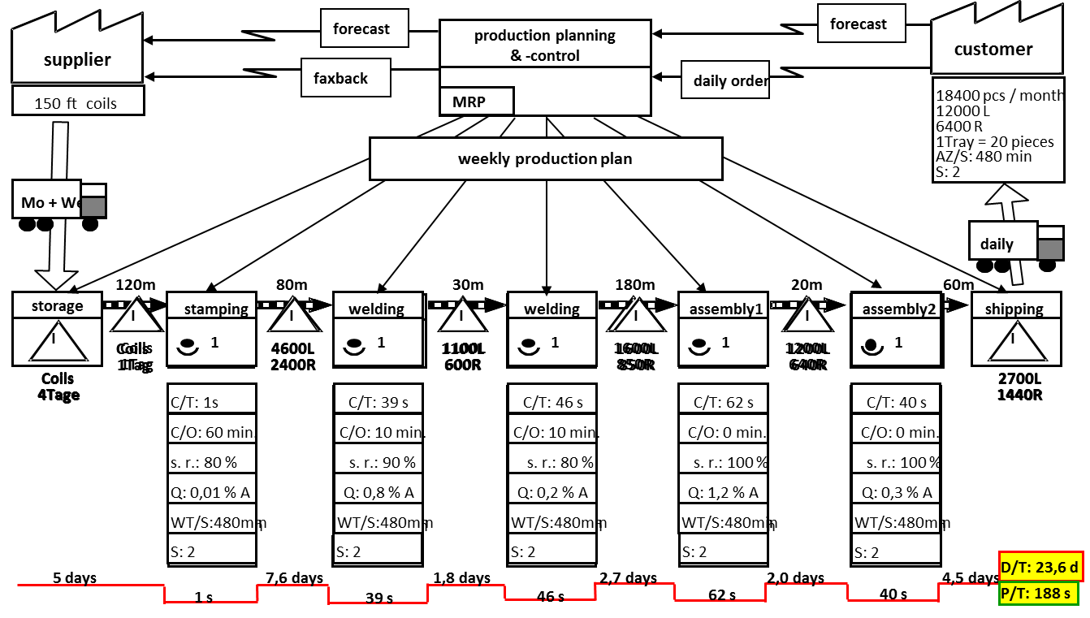
What is a Value Stream?
A value stream involves all the steps, both value added and non value added, required to complete a product or service from beginning to end
Notes:
It is important to note that a value stream must be an honest depiction of what is really happening. In order for the greatest improvements to take place, there must be thorough documentation of all non-value added activities.

Slide 55

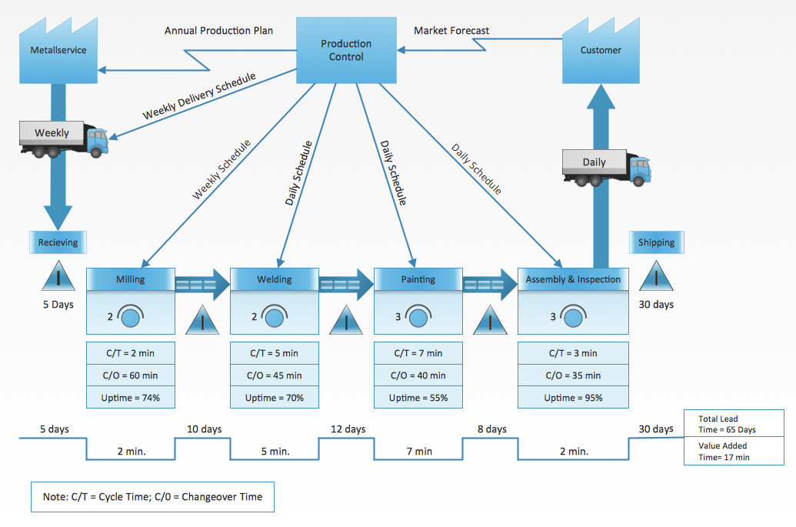
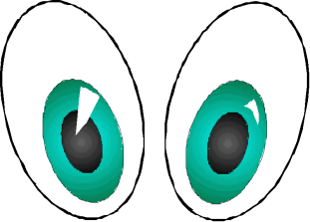
WHY DO VALUE STREAM MAPPING?
Implementation without a plan
will lead to disaster!
A Value Stream Map is a simple picture that helps you focus on flow and eliminate the waste
…Eyes for Waste
…Eyes for Flow
“Constantly shorten the time it takes to convert customer orders into deliveries.” Toyota Motor Company, TPS
Notes:
Explain that Value Stream Mapping is just one technique and is part of the Total System Strategy of DMS
Mention that a Value Stream Map is nothing more than a picture of the operation at a point in time and pictures help us see things more clearly
Emphasize - Eyes for Waste and Eyes for Flow

Slide 56

Why do Value Stream mapping?
Visualize the whole process (across functional boundaries)
Highlight sources of waste and put in place a plan to eliminate them
Provides a common language for improvement
Makes decisions about flow apparent
Ties together lean techniques
Forms the basis of an improvement plan
Shows linkage between information flow and material flows. No other tool does this.
    Gather data and turn it into an understanding
    Turn understanding into a plan
    Turn a plan into an action
Notes:
Information and Material flow through a Value Stream Map.

Slide 57
Value Stream Mapping
A tool originally used by the Toyota Production System experts to study processes
Developed and refined by John Shook and Mike Rother in Learning to See
Used in manufacturing, engineering and administrative offices by lean experts to improve business processes
Notes:
Although Toyota has a “flow mentality” where flow problems are continually being addressed on their manufacturing shop floors, there has not been an emphasis on flow within administrative processes.
Providing a copy of the book Learning to See during the training will allow participants to thumb through it during breaks. Stress that the book is a workbook and uses manufacturing shop floor examples.

Slide 58
What is a Value Stream?
A value stream involves all the steps, both value added and non value added, required to complete a product or service from beginning to end
Notes:
It is important to note that a value stream must be an honest depiction of what is really happening. In order for the greatest improvements to take place, there must be thorough documentation of all non-value added activities.

Slide 59
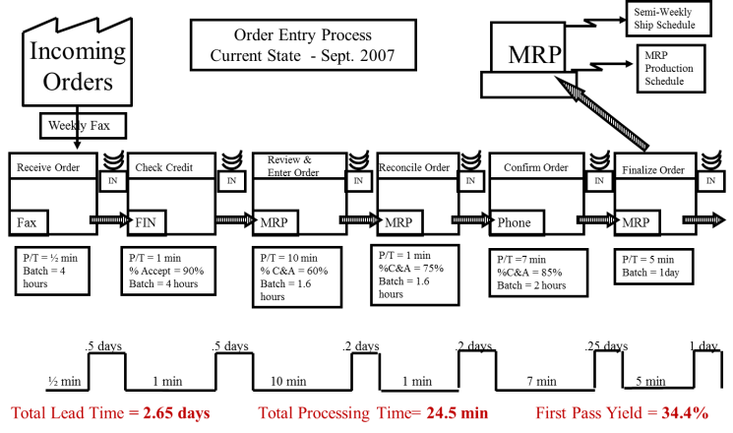
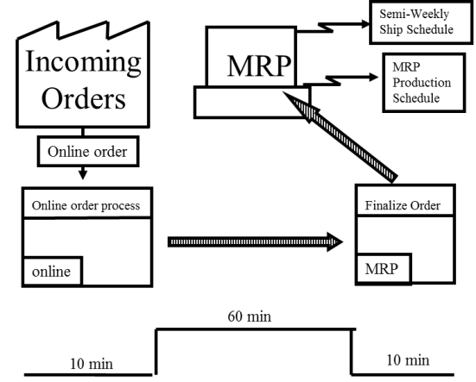
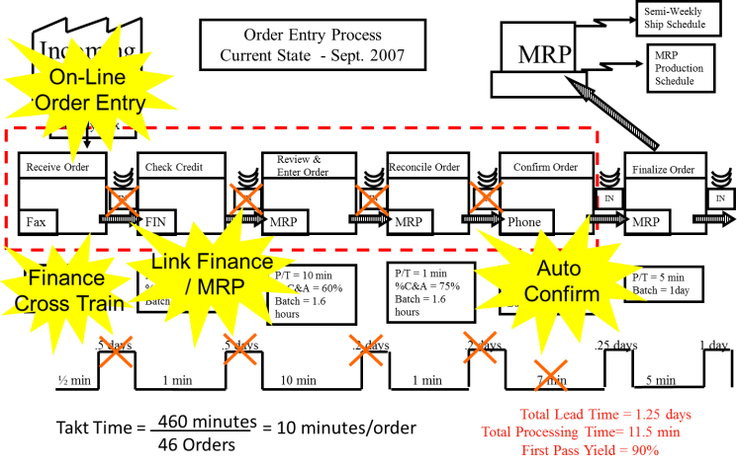
3 Types of VSM
Current State VSM
Future State VSM
Current State VSM with Opportunity

Slide 60
What Makes Value Stream Mapping Unique?
Visualizes the Process Flow from a systems perspective
Focuses on the customer and the customer’s requirements
Includes information flow and product movement
Summarizes the timeline as it relates to delivery to the customer
Documents performance characteristics of both the Value Stream and the individual process steps
Notes:
Systems Perspective: Looks at the relationship of the system to the environment as well as what is inside the system itself. First consideration is the survival of the system – effective exchange with the environment.
Information Flow: One of the powerful aspects of value stream mapping is the documentation of the “information flow.” Process engineering tools may not show information flow, yet experience has told us that 75% of the waste lies in the information flow.
Timeline: Another powerful aspect of value stream mapping is the tracking of time – or, how long it takes a single product to progress through the value stream.
Performance Characteristics: Value stream focuses on the flow of the process (improving flow removes waste). Improving individual process steps should be secondary to flow improvements.

Slide 61
Value Stream Map Elements
XYZ Org
Customer Orders
Supplier Orders
Internal Scheduling
Supplier
Customer
Delivery Freq.
Delivery Freq.
Process 1
I
Process 2
I
I
Inventory
Process Time
Wait Time
FTQ
Process Time
Wait Time
FTQ
Material
Movement
via PUSH
Lead Time
Notes:
There are six key components to a value stream map.
Customer
Process Steps
Data Attributes
Supplier with Materials
Information Flow
Calculate the overall performance of your value stream

Slide 62
VSM Analysis – Data Attributes
Lead time =
  Processing time + Wait Time / Delays
Typical batch size
First-Time Quality
  Reliability (e.g. system or equipment uptime)
Rework / revisions
  % Complete and Accurate Inputs (% C&A)
  Design Changes
  Errors
Number of people involved
  % utilization of people
Notes:
Process time, Wait Time, Lead Time and First Time Quality are the most important metrics – want to summarize at the bottom of the map. These are the key metrics we have committed to use; however, other metrics important to the particular map/value stream may also be selected and tracked.

Slide 63
Using the Value Stream Mapping Tool
Scoping the Value Stream
Determine the Value Stream to be improved
Understanding how things currently operate. This is the foundation for the future state.
Current state drawing
Future state drawing
Designing a lean flow through the enterprise.
Planning and Implementation
The goal of mapping!
Notes:
Each step must be included in its entirety. The planning and implementation phase must be implemented with an effective “management check” system that is supported by visual controls.

Slide 64
Components of VSM
Semi-Weekly
Ship Schedule
Order Entry Process
Current State - Sept. 2007
Supplier
ABX
MRP
MRP
Production
Schedule
Customer
ABX
Weekly Fax
Fax
Receive Order
Check Credit
Review & Enter Order
Reconcile Order
Confirm Order
Finalize Order
Finalize Order
IN
IN
IN
IN
IN
Fax
FIN
MRP
MRP
Phone
MRP
MRP
P/T = ½ min
Batch = 4
hours
P/T = 1 min
% Accept = 90%
Batch = 4 hours
P/T = 10 min
% C&A = 60%
Batch = 1.6 hours
P/T = 1 min
%C&A = 75%
Batch = 1.6 hours
P/T =7 min
%C&A = 85%
Batch = 2 hours
P/T = 5 min
Batch = 1day
.5 days
.5 days
.2 days
.2 days
.25 days
1 day
½ min
1 min
10 min
1 min
7 min
5 min
1 min
Process flow across the bottom
Each process have a data box
Customers outlined on the right
Suppliers outlined on the left
Information flow across the top
Timeline along the bottom
Symbols that provide insight into flows, process boxes as well as what happens between the process boxes

Slide 65
The Material Flow Symbols
Material Icons
Represents
Notes
WELDING
Manufacturing Process
One box equals an area of continuous
flow. All processes should be labeled.
Box also used to identify departments
such as production control.
Outside Sources
Used to show customers, suppliers
and outside manufacturing processes.
ABC
COMPANY
C/T=120 sec.
Used to record information concerning
a manufacturing process, department,
etc.
C/O=22 min.
3 SHIFTS
Process Data Box
W/T=20 hrs
3% SCRAP
I
Inventory
Count and time should be noted.
225 pieces
1.5 days
Tuesday
+ Thurs
Truck Shipment
Note the frequency of shipments.

Slide 66
The Material Flow Symbols
Material Icons
Represents
Notes
Identifies material movements that are
pushed by producer, not pulled by the
customer ( the following process ).
Movement of prod’n
material by PUSH
Movement of finished
goods to the customer
Also shows movement of raw material
and components from suppliers if
they are not pushed.
Supermarket
Physical pull
Pull of materials from a supermarket.
Transfer of controlled
quantities of material
between processes in a first in first out seq.
FIFO
Indicates a device to limit quantity
and ensure FIFO flow of material
between processes.

Slide 67
The Information Flow Symbols:
Information Icons
Represents
Notes
Manual flow of
information
For example: production schedule
shipping schedule
Electronic flow of
information
For example: EDI, Fax, etc.
Weekly
Schedule
Information
Describes an information flow.
OXOX
Load leveling
Tool to level the volume and mix of Kanban over a specific period of time.
Sequence-Pull Ball
Gives permission to produce a
predetermined type and quantity.
Buffer or safety stock
“Buffer” or “Safety Stock” must be
noted.

Slide 68
The Information Flow Symbols:
Information Icons
Represents
Notes
20
Tells a process how many of what
can be produced and gives permission
to do so.
Production Kanban
Withdrawal Kanban
Tells a process how many of what
can be withdrawn and gives permission
to do so.
Signal Kanban
Production instruction that orders
production from a batch process,
eg: stamping.
Kanban post
Place where Kanban are collected
and held for conveyance .
Highlights critical improvement needs
at specific processes. Can be used to
plan Kaizen events.
Lathe
Changeover
Kaizen burst

Slide 69
Value Stream Mapping :
Step by step

Slide 70
Getting Started
Define Team, Scope ( Start – End Process),
Key Metrics and Main Process Step
Identify project Sponsor/Champion
Identify task force and cross functional team
Identify the scope business area/process (Start & End)
Identify key Performance Metrics to be measured-analyzed
Tools:
Team Charter
SIPOC/Top- Down Charting/Swim lane Flow Chart

Slide 71
Getting Started
From Sand to Display Product at the customer
But...
Mapping the entire stream is too much for getting started!
Notes:
Ideally….coke

Slide 72
10 Steps VSM Analysis
Phase I - Current State VSM
Step 1 - Select Service/process
Step 2 - Establish Mapping and Data Collection Ground Rules.
Step 3 - Map the Process Flow (with Data Box)
Step 4 - Map the Material Flow
Step 5 - Indicate Time Pulse
Step 6 - Map the Information Flow
Step 7 – Identify VA & NVA
Phase II - Current State VSM with Opportunities
Step 8 – Identify opportunities through: Value Analysis, Waste Analysis, Root Cause Analysis, etc
Phase III - Future State VSM
Step 9 - Create future state VSM
Step 10 - Kaizen action plan

Slide 73
Step 1: Select Service / Process
Determine what individual product or service, or product group/family you will map
Has biggest impact on customer
High Impact on volume, quality, cost
Has common flow/same steps

Slide 74
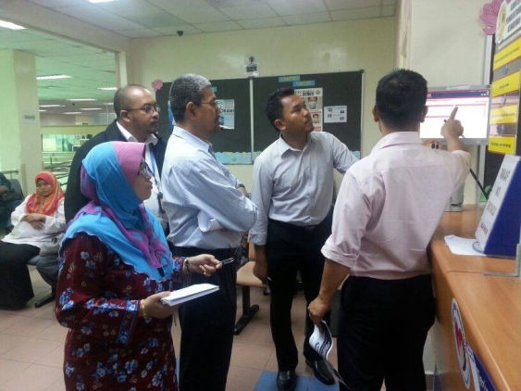
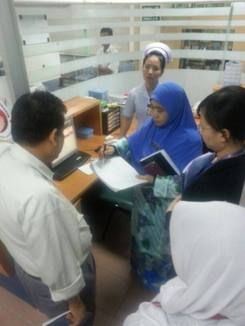
Step 2: Establish Mapping Rules
3 Simple Mapping and Data Collection Ground
Go to the Gemba! - Actual place where the process is performed.
Talk to the Actual people involved in the process and get the real facts.
Observe and chart the Actual process.
  Reality is invariably different from perception; Few processes work the way we think they do.
  The purpose of value stream mapping is to identify waste, not to develop the perfect process map.
GO WALK IT!
Understand the process through facts and data!

Slide 75
Value Stream Mapping
Best Practices
Always map in paper and pencil - rough out 1st, clean later.
Walk the actual material and information flows yourself.
Start with a quick walk, to get a feel for the flow and sequence then, go back and talk to the right people for each step. (Don’t forget second and third shifts)
Color Code the operations. (Red, Yellow, Green)
Always collect ‘current-state’ information while waking along the actual pathways of material and information flows.
Involve the Management team totally.
Don’t map the organization. Map
the flows through the organization.
Notes:
Cover these in detail, very important to take your time.

Slide 76
Step 3: Map the Process Flow (with Data Box)
Identify the major process steps and start mapping
120m
80m
30m
180m
20m
60m
storage
stamping
welding
assembly1
assembly2
Schweißen
Schweißen
Schweißen
welding
Montage1
Montage2
Schweißen
Schweißen
Schweißen
Schweißen
Schweißen
Montage1
Montage1
Montage1
Montage2
Montage2
Lager
Montage2
Versand
Lager
Stanzen
shipping
Lager
Lager
Stanzen
Stanzen
Stanzen
Versand
Versand
Versand
I
I
I
I
I
I
I
1
I
1
1
1
1
1
1
1
1
1
1
1
1
1
1
2700L
coils
2700L
2700L
1440R
4 days
1440R
Z/T: 1S
Z/T: 39 S
Z/T: 46 S
Z/T: 62 S
Z/T: 40 S
1440R
Z/T: 1S
C/T: 1S
Z/T: 39 S
C/T: 39 s
Z/T: 46 S
C/T: 46 s
Z/T: 62 S
C/T: 62 s
Z/T: 40 S
C/T: 40 s
R/T: 60 Min.
R/T: 10 Min.
R/T: 10 Min.
R/T: 0 Min.
R/T: 0 Min.
R/T: 60 Min.
C/O: 60 Min.
R/T: 10 Min.
C/O: 10 min.
R/T: 10 Min.
C/O: 10 min.
R/T: 0 Min.
C/O: 0 min.
R/T: 0 Min.
C/O: 0 min.
V: 85 %
Uptime: 90%
V: 100 %
Uptime: 80%
V: 80 %
Uptime:95%
V: 85 %
V: 100 %
V: 80 %
V: 100 %
V: 100 %
Uptime: 80%
V: 100 %
V: 100 %
Uptime:95%
Collect information for Data Box
Q: 0,01 % A
Q: 0,8 % A
Q: 0,2 % A
Q: 1,2 % A
Q: 0,3 % A
Q: 0,01 % A
FTY: 0.9
Q: 0,8 % A
FTY: 0.9
Q: 0,2 % A
FTY: 0.85
Q: 1,2 % A
FTY: 0.95
Q: 0,3 % A
FTY: 0.95
2 shift
2 shift
2 shift
2 shift
2 shift
Example ABC company:
The sequence of the several processes will be drafted after the first overview has been carried out and the appropriate data will be added in the proper data boxes.

Slide 77
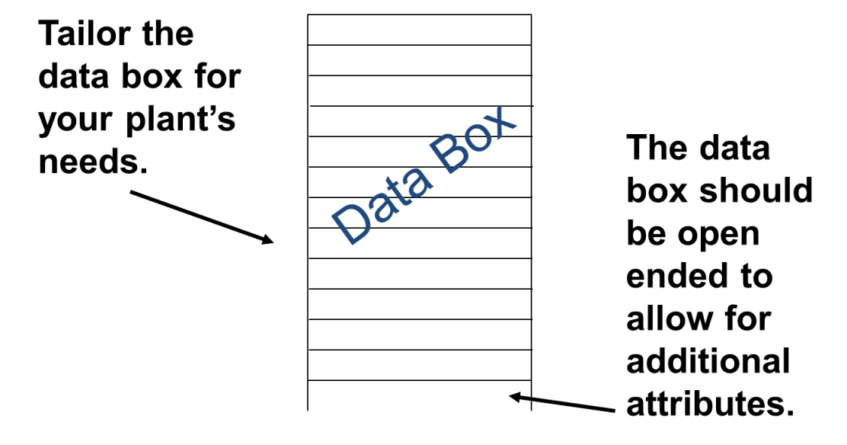
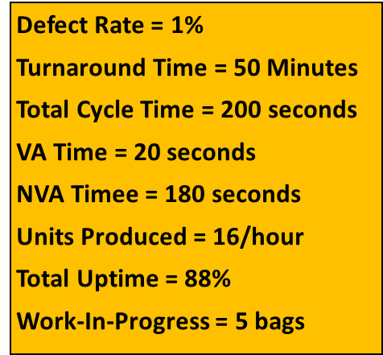
Data Box: Select Data Attributes
What to measure?
Should support a company’s objectives for the cost, service, and quality
Should highlight waste
Be flexible
Revise as necessary as the process tasks are defined
Select ones you may already be using
If there is time, seek out some baseline measures

Slide 78
Data Collection
Attribute Data to Collect
Shipping/Receiving schedules
Pack sizes at each process
Demand rates by process (Takt Time)
Working hours and breaks
Inventory Points (location & size)
How Operations are scheduled
Work-in-process inventory
Overtime per week
Process cycle times
Number of product variations at each step
Batch (lot) sizes
Changeover times/frequencies
C/O (changeover time)
OEE(Overall Equipment Effectiveness)
FTY (First Time Yield)
Scrap rate
Defect/Rework Rate
VA/ NVA Time
Batch Size/ Pack Size
Distance Traveled
Downtime
Etc..
Notes:
Mention that not all of these items are required for all value stream maps. Select the attributes that are most relevant to your operation or to a particular process.

Slide 79
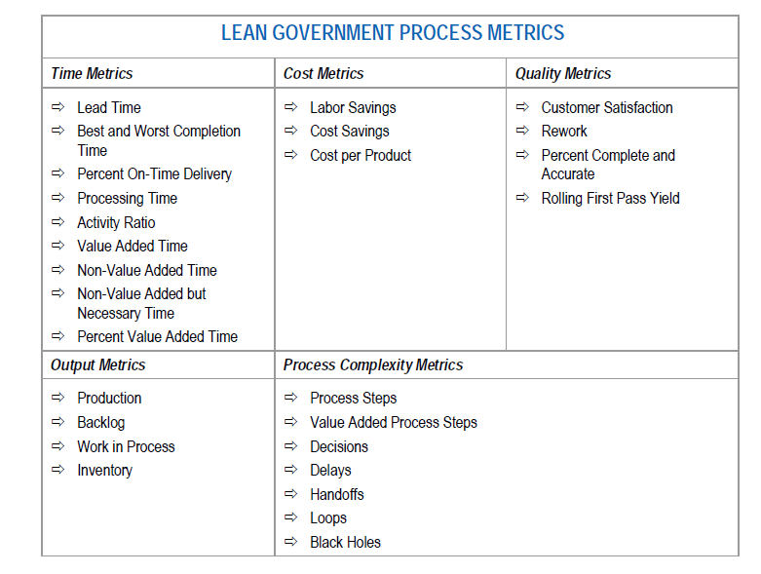
LEAN GOVERNMENT PROCESS METRICS
FTQ

Slide 80
Step 4: Map the Material Flow
supplier
customer
150 ft coils
18400 pcs / month
12000 L
6400 R
1Tray = 20 pieces
AZ/S: 480 min
Mo + We
daily
storage
120m
stamping
80m
welding
30m
180m
assembly1
20m
assembly2
60m
Schweißen
Schweißen
Schweißen
welding
Montage1
Montage2
Schweißen
Schweißen
Schweißen
Montage1
Montage1
Montage2
Lager
Montage2
Lager
Lager
Lager
Schweißen
Schweißen
Montage1
Montage2
Versand
Versand
Versand
Versand
Stanzen
shipping
Stanzen
Stanzen
I
Stanzen
I
I
I
I
I
I
I
I
I
I
I
I
I
I
I
I
I
I
I
I
I
1
I
1
1
1
1
1
1
1
1
1
1
1
1
1
coils
4600L
1
4600L
4600L
1100L
1100L
1100L
1600L
1600L
1600L
1200L
1200L
1day
2400R
600R
850R
1200L
1
640R
1
2400R
2400R
600R
600R
850R
850R
640R
coils
640R
2700L
2700L
2700L
1440R
4 days
1440R
Z/T: 1S
1440R
Z/T: 1S
C/T: 1S
Z/T: 39 S
Z/T: 39 S
C/T: 39 s
Z/T: 46 S
Z/T: 46 S
C/T: 46 s
Z/T: 62 S
Z/T: 62 S
C/T: 62 s
Z/T: 40 S
Z/T: 40 S
C/T: 40 s
R/T: 60 Min.
R/T: 60 Min.
C/O: 60 Min.
R/T: 10 Min.
R/T: 10 Min.
C/O: 10 min.
R/T: 10 Min.
R/T: 10 Min.
C/O: 10 min.
R/T: 0 Min.
R/T: 0 Min.
C/O: 0 min.
R/T: 0 Min.
R/T: 0 Min.
C/O: 0 min.
V: 85 %
V: 85 %
FTY.: 80 %
V: 100 %
V: 100 %
FTY.: 90 %
V: 80 %
V: 80 %
s. r.: 80 %
V: 100 %
V: 100 %
s. r.: 100 %
V: 100 %
V: 100 %
s. r.: 100 %
Q: 0,01 % A
Rejt: 0,01 % A
Q: 0,8 % A
Q: 0,8 % A
Q: 0,2 % A
Q: 0,2 % A
Q: 1,2 % A
Q: 1,2 % A
Q: 0,3 % A
Q: 0,01 % A
Q: 0,8 % A
Q: 0,2 % A
Q: 1,2 % A
Q: 0,3 % A
Q: 0,3 % A
AZ/S:480Min
AZ/S:480Min
WT/S:480Min
AZ/S:480Min
AZ/S:480Min
WT/S:480min
AZ/S:480Min
AZ/S:480Min
WT/S:480min
AZ/S:480Min
AZ/S:480Min
WT/S:480min
AZ/S:480Min
AZ/S:480Min
WT/S:480min
S: 2
S: 2
S: 2
S: 2
S: 2
S: 2
S: 2
S: 2
S: 2
S: 2
S: 2
S: 2
S: 2
S: 2
S: 2
Example ABC company:
Now the entire material flow from the supplier across the manufacturing to the customer will be added to the actual map.
The arrows of the material flow symbolize a push-system.

Slide 81
Step 5: Indicate Time Pulse
(Cycle Time, Waiting Time and Lead time)
XYZ AG
supplier
customer
Krupp
-
Stahl
150
ft
coils
18400 pcs / month
12000 L
6400 R
1Tray = 20 pieces
AZ/S: 480 min
S: 2
Mo &Mi
Mo + We
täglich
daily
storage
120m
80m
30m
180m
20m
60m
Lager
welding
Versand
Schweißen
welding
Schweißen
Montage1
Schweißen
assembly1
Schweißen
Schweißen
Schweißen
Montage1
Montage1
Montage2
Montage2
Montage2
Lager
assembly2
Lager
Stanzen
Stanzen
Versand
Lager
Stanzen
Versand
stamping
Versand
I
Stanzen
I
Schweißen
I
Schweißen
I
Montage1
I
Montage2
shipping
I
I
I
I
I
I
I
I
I
I
I
I
I
I
I
I
I
1
I
1
1
1
1
1
1
1
1
1
1
1
1
1
Coils
4600L
1100L
1600L
1200L
1
Coils
Coils
4600L
4600L
1100L
1100L
1600L
1600L
1200L
1Tag
2400R
600R
850R
1200L
1Tag
2400R
640R
2400R
600R
600R
850R
850R
640R
Coils
640R
2700L
Coils
Coils
2700L
4Tage
2700L
4Tage
1440R
4Tage
1440R
Z/T: 1S
1440R
C/T: 1s
Z/T: 39 S
C/T: 39 s
Z/T: 46 S
C/T: 46 s
Z/T: 62 S
C/T: 62 s
Z/T: 40 S
Z/T: 1S
Z/T: 39 S
Z/T: 46 S
Z/T: 62 S
C/T: 40 s
Z/T: 40 S
R/T: 60 Min.
C/O: 60 min.
R/T: 10 Min.
C/O: 10 min.
R/T: 10 Min.
C/O: 10 min.
R/T: 0 Min.
C/O: 0 min.
R/T: 0 Min.
R/T: 60 Min.
R/T: 10 Min.
R/T: 10 Min.
R/T: 0 Min.
C/O: 0 min.
R/T: 0 Min.
V: 85 %
s. r.: 80 %
V: 100 %
s. r.: 90 %
V: 80 %
s. r.: 80 %
V: 100 %
s. r.: 100 %
V: 100 %
V: 85 %
V: 100 %
V: 80 %
V: 100 %
s. r.: 100 %
V: 100 %
Q: 0,01 % A
Q: 0,01 % A
Q: 0,8 % A
Q: 0,8 % A
Q: 0,2 % A
Q: 0,2 % A
Q: 1,2 % A
Q: 1,2 % A
Q: 0,3 % A
Q: 0,01 % A
Q: 0,8 % A
Q: 0,2 % A
Q: 1,2 % A
Q: 0,3 % A
Q: 0,3 % A
AZ/S:480Min
WT/S:480min
AZ/S:480Min
WT/S:480min
AZ/S:480Min
WT/S:480min
AZ/S:480Min
WT/S:480min
AZ/S:480Min
AZ/S:480Min
AZ/S:480Min
AZ/S:480Min
AZ/S:480Min
WT/S:480min
AZ/S:480Min
S: 2
S: 2
S: 2
S: 2
S: 2
S: 2
S: 2
S: 2
S: 2
S: 2
S: 2
S: 2
S: 2
S: 2
S: 2
5 days
7,6 days
1,8 days
2,7 days
2,0 days
4,5 days
W/T: 23,6 d
1 s
39 s
46 s
62 s
40 s
P/T: 188 s

Slide 82
Step 6 - Map the Information Flow
Example ABC company:
Now the entire information flow from the supplier across the manufacturing to the customer will be added to the actual map.
forecast
production planning
& -control
forecast
customer
supplier
XYZ AG
Krupp
-
Stahl
faxback
daily order
150
ft
coils
MRP
18400 pcs / month
12000 L
6400 R
weekly production plan
1Tray = 20 pieces
AZ/S: 480 min
S: 2
Mo &Mi
Mo + We
täglich
daily
storage
120m
80m
30m
180m
20m
60m
Schweißen
Schweißen
Schweißen
Schweißen
Montage1
welding
Montage1
Montage2
Schweißen
welding
Schweißen
Montage1
Lager
assembly1
Montage2
Versand
Montage2
Lager
Stanzen
assembly2
stamping
Versand
Lager
shipping
Lager
Stanzen
Stanzen
Versand
I
Stanzen
I
Schweißen
I
Schweißen
I
Montage1
I
Montage2
Versand
I
I
I
I
I
I
I
I
I
I
I
I
I
I
I
I
I
1
I
1
1
1
1
1
1
1
1
1
1
1
1
1
Coils
4600L
1100L
1600L
1200L
1
Coils
Coils
4600L
4600L
1100L
1100L
1600L
1600L
1200L
1Tag
2400R
600R
850R
1200L
1Tag
640R
1Tag
2400R
2400R
600R
600R
850R
850R
640R
Coils
640R
2700L
Coils
Coils
2700L
4Tage
2700L
4Tage
1440R
4Tage
1440R
Z/T: 1S
1440R
C/T: 1s
Z/T: 39 S
C/T: 39 s
Z/T: 46 S
C/T: 46 s
Z/T: 62 S
C/T: 62 s
Z/T: 40 S
Z/T: 1S
Z/T: 39 S
Z/T: 46 S
Z/T: 62 S
C/T: 40 s
Z/T: 40 S
R/T: 60 Min.
C/O: 60 min.
R/T: 10 Min.
C/O: 10 min.
R/T: 10 Min.
C/O: 10 min.
R/T: 0 Min.
C/O: 0 min.
R/T: 0 Min.
R/T: 60 Min.
R/T: 10 Min.
R/T: 10 Min.
R/T: 0 Min.
C/O: 0 min.
R/T: 0 Min.
V: 85 %
s. r.: 80 %
V: 100 %
s. r.: 90 %
V: 80 %
s. r.: 80 %
V: 100 %
s. r.: 100 %
V: 100 %
V: 85 %
V: 100 %
V: 80 %
V: 100 %
s. r.: 100 %
V: 100 %
Q: 0,01 % A
Q: 0,01 % A
Q: 0,8 % A
Q: 0,8 % A
Q: 0,2 % A
Q: 0,2 % A
Q: 1,2 % A
Q: 1,2 % A
Q: 0,3 % A
Q: 0,01 % A
Q: 0,8 % A
Q: 0,2 % A
Q: 1,2 % A
Q: 0,3 % A
Q: 0,3 % A
AZ/S:480Min
WT/S:480min
AZ/S:480Min
WT/S:480min
AZ/S:480Min
WT/S:480min
AZ/S:480Min
WT/S:480min
AZ/S:480Min
AZ/S:480Min
AZ/S:480Min
AZ/S:480Min
AZ/S:480Min
WT/S:480min
AZ/S:480Min
S: 2
S: 2
S: 2
S: 2
S: 2
S: 2
S: 2
S: 2
S: 2
S: 2
S: 2
S: 2
S: 2
S: 2
5 days
7,6 days
1,8 days
2,7 days
2,0 days
S: 2
4,5 days
D/T: 23,6 d
1 s
39 s
46 s
62 s
40 s
P/T: 188 s

Slide 83

Towards Future State Value Stream
A simple way to approach the Future State Map is to begin by modifying the Current State Map.

Slide 84
Example VSM in action
Semi-Weekly
Ship Schedule
Incoming
Orders
Order Entry Process
Current State - Sept. 2007
MRP
MRP
Production
Schedule
Weekly Fax
Receive Order
Check Credit
Review & Enter Order
Reconcile Order
Confirm Order
Finalize Order
IN
IN
IN
IN
IN
IN
Fax
FIN
MRP
MRP
Phone
MRP
P/T = ½ min
Batch = 4
hours
P/T = 1 min
% Accept = 90%
Batch = 4 hours
P/T = 10 min
% C&A = 60%
Batch = 1.6 hours
P/T = 1 min
%C&A = 75%
Batch = 1.6 hours
P/T =7 min
%C&A = 85%
Batch = 2 hours
P/T = 5 min
Batch = 1day
.5 days
.5 days
.2 days
.2 days
.25 days
1 day
½ min
1 min
10 min
1 min
7 min
5 min
Total Lead Time = 2.65 days
Total Processing Time= 24.5 min
First Pass Yield = 34.4%

Slide 85
Step 7 – Identify VA & NVA
Semi-Weekly
Ship Schedule
Incoming
Orders
Order Entry Process
Current State - Sept. 2007
MRP
MRP
Production
Schedule
What does the customer really need?
Weekly Fax
Receive Order
Check Credit
Review & Enter Order
Reconcile Order
Confirm Order
Finalize Order
IN
IN
IN
IN
IN
IN
Fax
FIN
MRP
MRP
Phone
MRP
All orders will be processed within one hour of receipt (6 orders processed each hour).
P/T = ½ min
Batch = 4
hours
P/T = 1 min
% Accept = 90%
Batch = 4 hours
P/T = 10 min
% C&A = 60%
Batch = 1.6 hours
P/T = 1 min
%C&A = 75%
Batch = 1.6 hours
P/T =7 min
%C&A = 85%
Batch = 2 hours
P/T = 5 min
Batch = 1day
How often will we check our performance to customer needs?
.5 days
.5 days
.2 days
.2 days
.25 days
1 day
½ min
1 min
10 min
1 min
7 min
5 min
Total Lead Time = 2.65 days
Total Processing Time= 24.5 min
First Pass Yield = 34.4%
Notes:
________________________________________________________________________________________________________________________________________________________________________________________________________________________________________________________________________________________________________________________________________________________________________

Slide 86
Process Streamlining – Removing NVA
Eliminate Non-Value Add Tasks:
  Handling
  Paperwork
  Counting, Issuing, Retrieving
  Wait
  Proofreading
  Inspection and checking
  Sorting work
NVA
  Logging information
  Checking calculations
  Reviewing and approving
  Moving and set-up
  Monitoring work
  Any type of rework

Slide 87
Analysis Tools to identify opportunities
Value Analysis
Waste Analysis
Root Cause Analysis
  5 Whys
  Fishbone Diagram
  Fault Tree Analysis
Eliminate, Combine, Rearrange or Simplify

Slide 88

Design Future State - Purpose
Define how the plant will operate in the future
Serve as the blueprint for implementation
Without it, the Current State Map is nothing more than wallpaper!
Notes:
You need to have a future state map in order to complete a site plan and satisfy Flow Manufacturing criteria for the DMS Gap Assessment.

Slide 89
Kaizen Blitz
Add the sign of a “Kaizen Blitz” to show “Kaizen” interventions that help you move from the current to the future state
?
?
?

Slide 90
Semi-Weekly
Ship Schedule
Incoming
Orders
Order Entry Process
Current State - Sept. 2007
MRP
MRP
Production
Schedule
Phone
Or WEB
Weekly Fax
Stop walking to the FAX that’s waste!!!
Rework
Over Processing
Receive Order
Check Credit
Review & Enter Order
Reconcile Order
Confirm Order
Finalize Order
Waste
Waste
IN
IN
IN
IN
IN
IN
Fax
FIN
MRP
MRP
Phone
MRP
Which steps create value?
Which are waste?
P/T = ½ min
Batch = 4
hours
P/T = 1 min
% Accept = 90%
Batch = 4 hours
P/T = 10 min
% C&A = 60%
Batch = 1.6 hours
P/T = 1 min
%C&A = 75%
Batch = 1.6 hours
P/T =7 min
%C&A = 85%
Batch = 2 hours
P/T = 5 min
Batch = 1day
.5 days
.5 days
.2 days
.2 days
.25 days
1 day
½ min
1 min
10 min
1 min
7 min
5 min
460 minutes
46 Orders
Total Lead Time = 2.65 days
Takt Time =
= 10 minutes/order
Total Processing Time= 24.5 min
First Pass Yield = 34.4%
Notes:
________________________________________________________________________________________________________________________________________________________________________________________________________________________________________________________________________________________________________________________________________________________________________

Slide 91
Semi-Weekly
Ship Schedule
On-Line
Order Entry
Order Entry Process
Current State - Sept. 2007
Incoming
Orders
MRP
MRP
Production
Schedule
How can we flow work with fewer interruptions?
Weekly Fax
Receive Order
Check Credit
Review & Enter Order
Reconcile Order
Confirm Order
Finalize Order
IN
IN
IN
IN
IN
IN
Fax
Link Finance
/ MRP
FIN
MRP
MRP
Phone
MRP
Auto
Confirm
Finance
Cross Train
P/T = ½ min
Batch = 4
hours
P/T = 1 min
% Accept = 90%
Batch = 4 hours
P/T = 10 min
% C&A = 60%
Batch = 1.6 hours
P/T = 1 min
%C&A = 75%
Batch = 1.6 hours
P/T =7 min
%C&A = 85%
Batch = 2 hours
P/T = 5 min
Batch = 1day
.5 days
.5 days
.2 days
.2 days
.25 days
1 day
½ min
1 min
10 min
1 min
7 min
5 min
Total Lead Time = 1.25 days
Takt Time =
460 minutes
46 Orders
NEW METRICS!
Total Processing Time= 11.5 min
= 10 minutes/order
First Pass Yield = 90%
Notes:
________________________________________________________________________________________________________________________________________________________________________________________________________________________________________________________________________________________________________________________________________________________________________

Slide 92
Continuous Improvement through VSM
Current
state
Identify
waste
Continuous
Incremental
Improvement
Measure
&
Adjust
Future
state
Implement

Slide 93
Order Entry Process
Future State - Sept. 2007
Incoming
Orders
Semi-Weekly
Ship Schedules
MRP
Schedule
Production
via FG Kanban
Phone / Web
MRP
Production
Schedule
Implement
Kanban
Receive / Credit
Check / Reconcile
Confirm
Kanban will:
Schedule Production to real time demand.
Optimize (level) and Control Inventory.
Link Production to Customer Demand.
MRP/FIN
P/T < 10 min
% accept = 90%
Batch = 1
How can we control work between interruptions?
Notes:
________________________________________________________________________________________________________________________________________________________________________________________________________________________________________________________________________________________________________________________________________________________________________

Slide 94
Order Entry Process
Future State - Sept. 2007
Incoming
Orders
Semi-Weekly
Ship Schedules
MRP
Phone / Web
Schedule
Production
via FG Kanban
Receive / Credit
Check / Reconcile
Confirm
I.T. Link to
Order Entry
Shipping
Training
Direct
Schedule
Shipping
MRP/FIN
P/T < 10 min
% accept = 90%
Batch = 1
If FG Kanban is implemented what improvements can be made to Shipping?
Notes:
________________________________________________________________________________________________________________________________________________________________________________________________________________________________________________________________________________________________________________________________________________________________________

Slide 95
Order Entry Process
Future State - Sept. 2007
Incoming
Orders
MRP
Phone / Web
Schedule
Production
via FG Kanban
Receive / Credit
Check / Reconcile
Confirm
Shipping
MRP/FIN
P/T < 10 min
% accept = 90%
Batch = 1
Total Lead Time < 10 Minutes
Future State Metrics!
Total Processing Time < 10 Minutes
First Pass Yield > 90%
Notes:
________________________________________________________________________________________________________________________________________________________________________________________________________________________________________________________________________________________________________________________________________________________________________

Slide 96
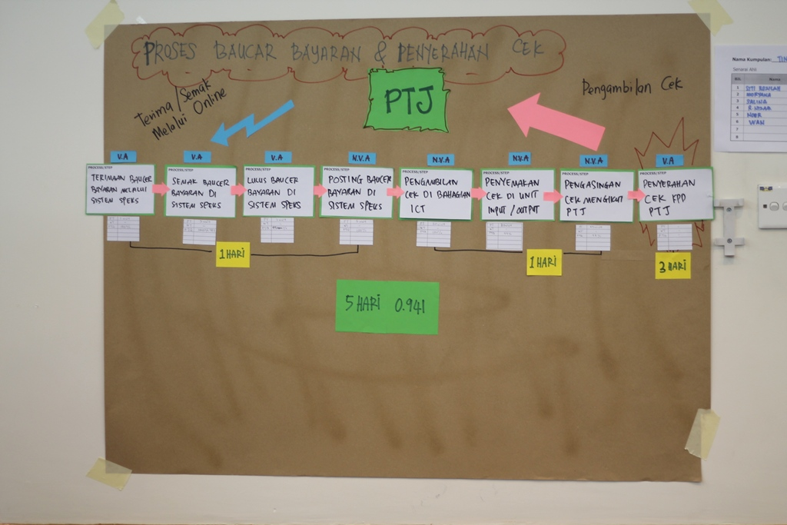
VSM Discussion Example – Current State

Slide 97
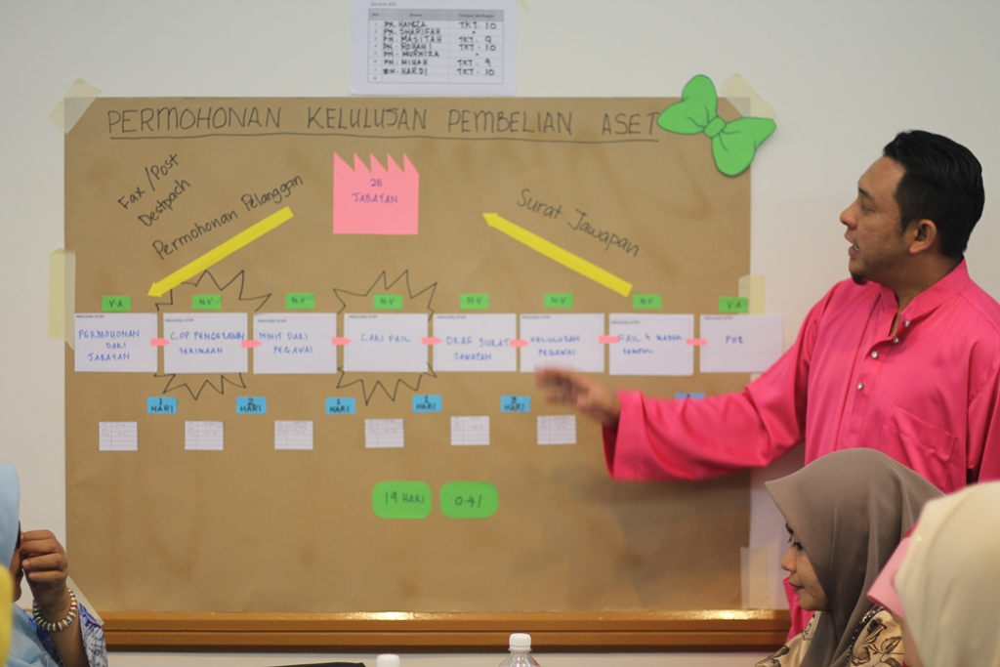
VSM Discussion Example – Current State

Slide 98


Slide 99

Step 10: Improvement Activities to achieve the future state
A Yearly Value Steam Project Pipeline

Slide 100
Value Stream Managers
Each Value Stream Needs a Value Stream Manager
Process 1
Process 2
Process 3
Customer
Kaizen
For product ownership beyond functions
Assign responsibility for the future state mapping and implementing lean value streams to line managers with the capability to make change happen across functional and departmental boundaries.
Value stream managers should make their progress reports to the top manager on site.
The Value Stream Manager

Slide 101
Future State Map
“Do It”
Implement - Implement - Implement
Action - Action - Action - Action - Action
“Check It - Follow up”

